Slide 1
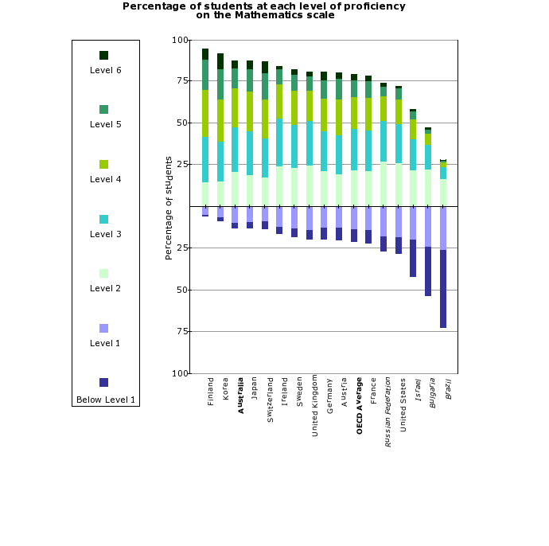
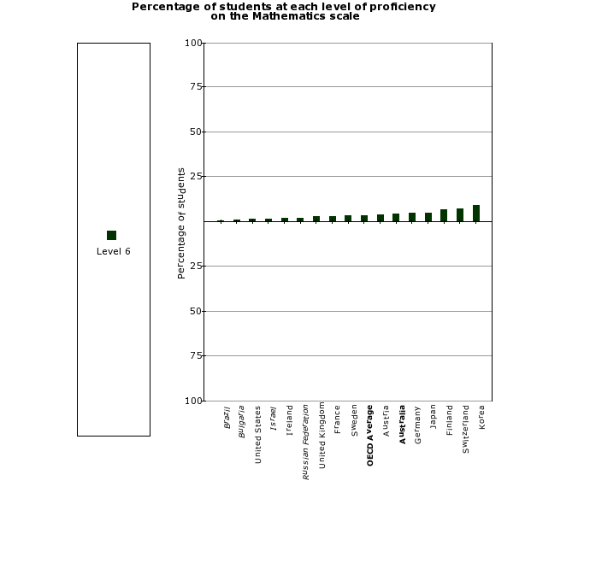
Mathematics for Young People:
Where does Ireland stand?
International tests like PISA and TIMMS, show that Irish children do relatively well in basic mathematics skills, but need more practice with creative problem solving. This will help them prepare for the jobs of tomorrow.

Slide 2
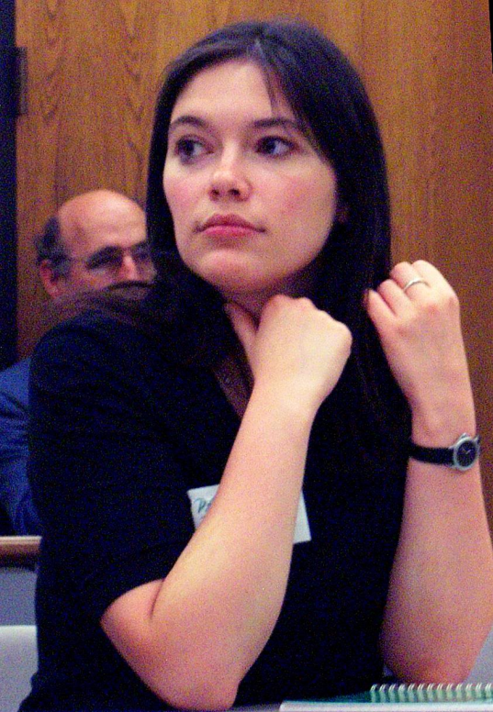
Who helped you develop your interest in mathematics and how?
Here I must mention a math circle I went to … It was an absolutely amazing experience! …we all felt that nothing out there could even compare to what we were doing… As I studied more mathematics over the next ten years, the problems got harder, the lectures got more complicated, but the feeling that there is nothing better I could possibly do with my time is still there.
Maths Circles started 100 ago in Europe as a way to help students enjoy the beautiful side of mathematics. They have since inspired young people from across the world.
Maria Chudnovsky
Associate Professor
Columbia University

Slide 3
Maths Circles
Weekly 1 hour Meetings, after school or lunchtime.
Introduce mathematical concepts using games and constructive activities.
Encourage an appreciation/enjoyment of maths.
Develop problem solving skills based on an investigative method, pattern guessing, trial-and-error, logic.
Develop independent and team working skills.
Develop an intuitive understanding of new mathematical concepts.
Develop critical thinking – a wish to understand rather than accept rules blindly.
Content developed in collaboration by teachers, university lecturers and students, who may also help with delivery.

Slide 4
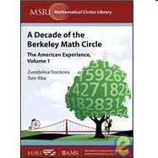
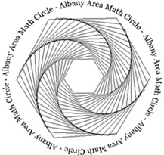
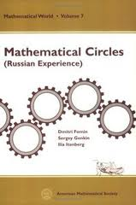
Maths Circles around the world
- Emphasize exploration and discovery.
- Informal atmosphere.
- Dedicated teachers -> dedicated students.
- Friendship, encouragement and support.
http://www.mathcircles.org/

Slide 5
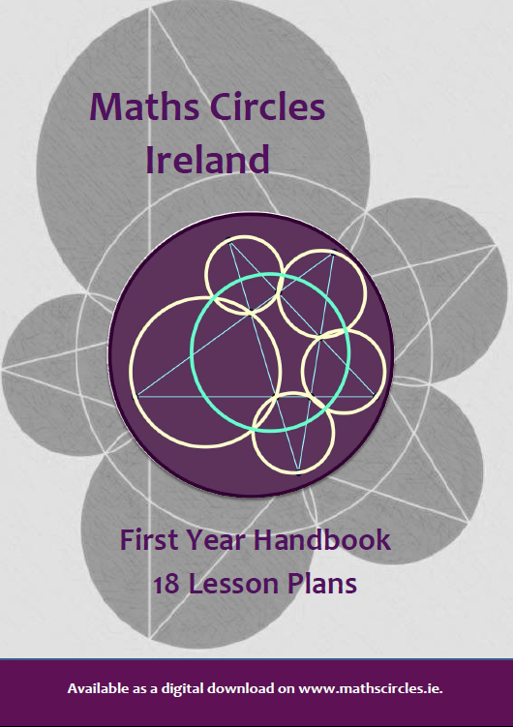
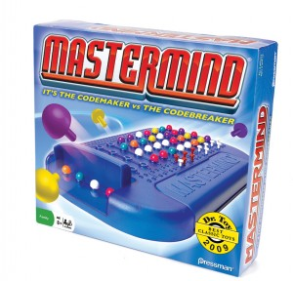
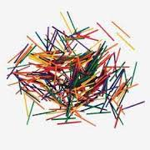
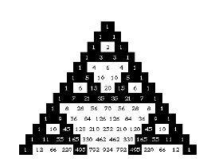
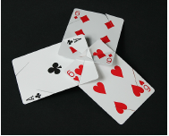
Maths Circles Ireland Secondary Schools – Junior Cycle
Mastermind:
Logic/Combinatorics
Nim: Divisibility
Sequences:
Probabilities,
Equations
genius

Slide 6
Sample 1st year Maths Circles lesson
Warm-Up Problem (5-10 mins): Calculator Trick
Take a three-digit number, e.g. 345, and write it out twice, to get 345,345.
Now, take this number, and then divide it by 7. Divide this answer by 11. Finally, divide this answer by 13. What do you get? Explain why.
Puzzle Stations (10-15 mins each)
Nim: The Game. Students play in pairs. A pile of 32 matchsticks is placed in the middle of the table, and players take turns removing one, two, or three sticks at a time. The aim of the game is to be the last person to remove a stick.
Filling Jugs. Students use unmarked jugs of 3, 5, and 8 litres to get exactly 4 litres of water. We got students to use their imagination rather than actual jugs.
Magic Squares. Students are given the numbers 1-9, cut out onto small squares, and asked to arrange them into a 3x3 square, so that each row, column, and diagonal adds to the same number.

Slide 7
Sample 1st year Maths Circles lesson
Warm-up Problem: Calculator Trick
Solution
345,345 =345,000 + 345= $345×1000+345×1=345×1001$. So to get 345,345 from 345 you need to multiply by 1,001. Working in reverse, to get 345 from 345,345 you have to divide by 1001. The prime factors of 1,001 are 7 x 11 x 13.
Extensions
To make a similar trick with 2-digit number, you’d have to multiply by 101, e.g. 101 x 56 = 5,656. However, as 101 is prime, the trick can’t be disguised by breaking it into prime factors, which is why it’s not such a cool trick with 2-digit numbers.
For a trick with 4-digit numbers you would need
10,001 = 73 x 137.
For 5-digit numbers you would need 100,001 = 11 x 9091.

Slide 8
Sample 1st year Maths Circles lesson
Nim: The Game
This is a game for two players.
A bundle of 32 matchsticks is put in the middle of the table.
Players take turns to remove 1, 2, or 3 sticks at a time. The winner is the person who removes the last stick.
The question is: is it possible for one of the players to figure out a strategy, so that they always win?

Slide 9
Sample 1st year Maths Circles lesson
Nim: The Game
This is a game for two players.
A bundle of 32 matchsticks is put in the middle of the table.
Players take turns to remove 1, 2, or 3 sticks at a time. The winner is the person who removes the last stick.
The question is: is it possible for one of the players to figure out a strategy, so that they always win?
Hints
If 32 is too large, you could first start a game with 4 matchsticks.
Then start a game with 8 matchsticks… Every time, last game’s winner will try to bring the other player back to a losing position…

Slide 10
Sample 1st year Maths Circles lesson
Nim: The Game
Solution.
The second player always wins. If the first player removes x sticks, the second player removes 4 – x sticks.
Because a player can only remove one, two, or three sticks, this is always possible.
Thus the total number of sticks, after the second player takes their turn, will be (32), 28, 24, 20, … , 4, 0.
This means that the person going second wins, as long as the starting number is a multiple of four.

Slide 11
Sample 1st year Maths Circles lesson
Nim: The Game
Extensions.
If the starting number isn’t a multiple of 4, the person going first removes 1, 2, or 3 sticks so that the number left is a multiple of 4, and then they (the person going first) will win.
If the rules change so that you could only take only 1 or 2 sticks at a time, then the trick is to look at multiples of 3. So the person going second will win if the starting number is a multiple of three, otherwise the person going first will win. In the case with 32 matchsticks, the person going first removes 2 matchsticks. Then, if the person going second removes x matchsticks, the person going first removes 3 – x matchsticks, and will win.
If the rules change so you can take 1, 2, 3 or 4 matchsticks, then it is the multiples of 5 that determine the winner. The second person will win if starting on a multiple of five, and the first person will win otherwise.

Slide 12
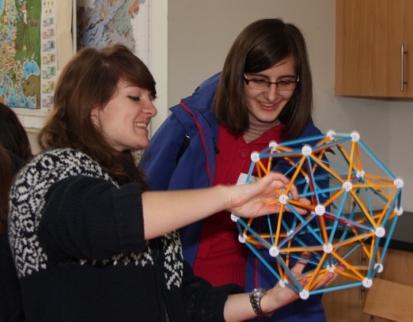
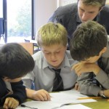
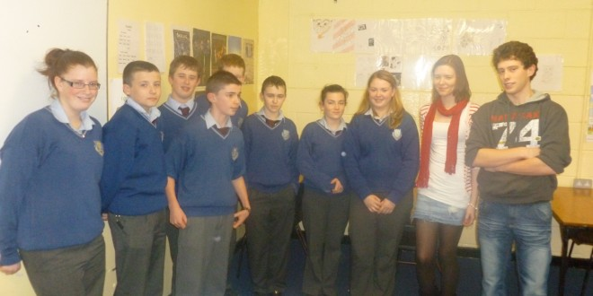
Reflections
“The Maths Circle... was a great success last year and we are eager to continue this year. The tutors were enthusiastic and it rubbed off on our students.”
Siobhan McGrath,
Presentation Brothers College
“Students developed their mathematical skills in a very different learning environment from the classroom ... It was really interesting to see students completing the same problem using very different methods.”
Sarah O Donovan, St. Aloysius
“I found that the Maths Circle helped students gain more confidence in both their Mathematical ability and ability to express themselves to their class mates. Students developed new methodologies which they brought to their Maths classes but most importantly they found that Maths is fun!”
Joan Hough, St. Aidans Community College
genius

Slide 13
Useful webpages
Maths Circles Ireland Webpage:
mathscircles.ie
Irish Mathematical Trust Webpage:
www.irishmathstrust.com/teachers-maths-circles
Links to more than 30 junior cycle and 12 primary lessons.
www.irishmathstrust.com/miol
Lessons celebrating George Boole and William Rowan Hamilton

Slide 14
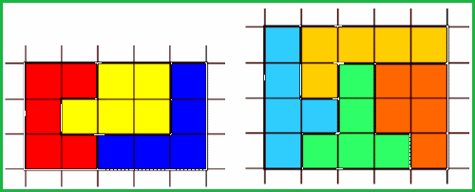
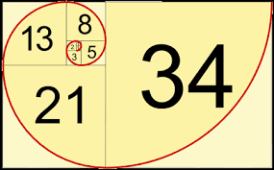
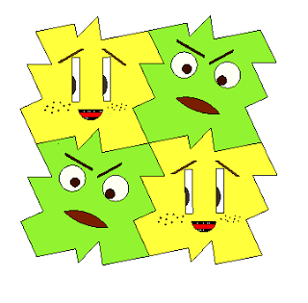
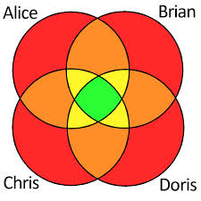
Maths Circles Ireland Primary Schools
Pentomino Puzzles:
Fibonacci Numbers:
Tessellations:
Sets:
Hamilton Circuits
genius

Slide 15
Primary Maths Circles
Let the games begin

Slide 16
Pascal’s Triangle: Click to see how it’s built: movie
210
210

Slide 17
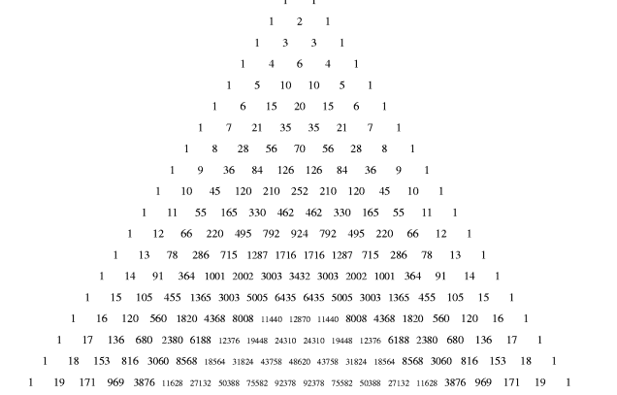
Colour on top of all the even numbers in Pascal’s triangle …

Slide 18
Recall: Even and Odd numbers
Even numbers can be divided exactly by 2.
Even numbers end in 0, 2, 4, 6, 8.
Odd numbers yield a remainder of 1 when divided by 2.
Odd numbers end in 1, 3, 5, 7, 9.

Slide 19
Solution:
Our very own fractal

Slide 20
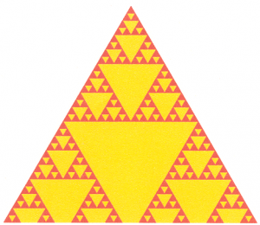
Solution
magnified

Slide 21
Fractals
Fractals tend to occur when we create a geometric picture by applying the same rule again and again.
For example, Pascal’s triangle was constructed by always adding two numbers and writing the result in the space midway below them.

Slide 22
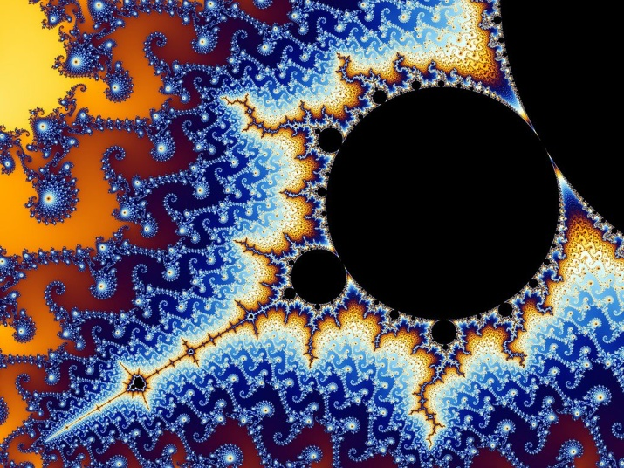
Fractals
Fractals are geometrical figures whose fragments, when zoomed, look like the whole picture again.
One of the most famous mathematical fractals is the Mandelbrot set. Click on the link to see it zoomed in a movie.

Slide 23
Why do fractals occur in nature ?
List 3 things in nature that look a lot like fractals.
Click on the link above to find more.

Slide 24
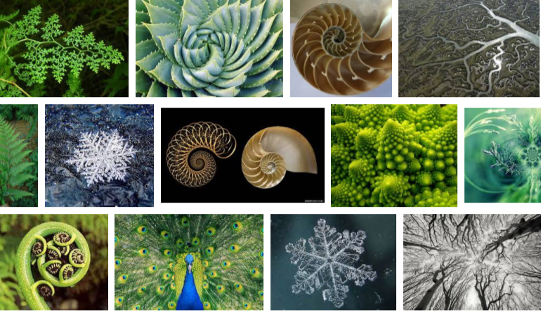
Why do fractals occur in nature ?
List 3 things in nature that look a lot like fractals.
Click on the link above to find more.

Slide 25
Why do fractals occur in nature ?
Some Answers:
Living beings tend to take the shape that best protects them and helps them find energy.
For example, seashells are round because this shape allows them to get the most space inside for smallest shell outside.
Fractals tend to occur when the same rule is repeated again and again.
Once living things have found their best shape to grow, they repeat the same rule for growth every year at larger scales.

Slide 26
Why do fractals occur in maths ?
Example: Pascal’s triangle
Fractals tend to occur when the same rule is repeated again and again.
In Pascal’s triangle, we always added two numbers and wrote the result midway below them.
Even + Even = Even
Hence in Pascal’s triangle, when we had some even numbers in a row, then an entire triangle below them was even.

Slide 27
Why do fractals occur in maths ?
Example: Pascal’s triangle
Fractals tend to occur when the same rule is repeated again and again.
In Pascal’s triangle, we always added two numbers and wrote the result midway below them.
Odd + Even = Even
This rule applies along the slanted edges of the even number triangles.

Slide 28
Why do fractals occur in maths ?
Example: Pascal’s triangle
Fractals tend to occur when the same rule is repeated again and again.
In Pascal’s triangle, we always added two numbers and wrote the result midway below them.
Odd + Odd = Even
This rule helped create new even triangles under rows of odd numbers in Pascal’s triangle.
You’ll be able to explain more fractal properties of Pascal’s triangle when you’ll learn about binary numbers when you’re older…

Slide 29
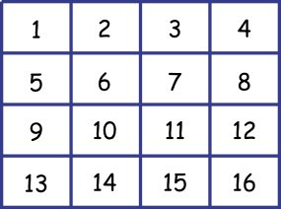
Reading your mind
How to play:
1:Circle a number on a row
2:Then cross off all of the other numbers in the
same column and row of the number that you circled.
3:repeat step 1 and 2 until you have 4 numbers.
The sum of the 4 numbers is …………………

Slide 30
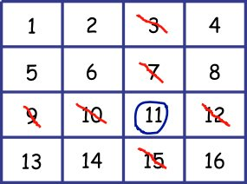
Example

Slide 31
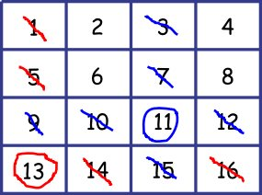
Example

Slide 32
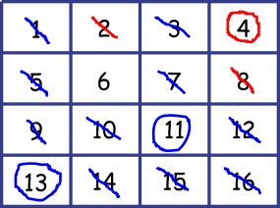
Example

Slide 33
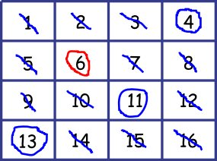
Example
4+6+11+13=34

Slide 34
Reading your mind: Solution
The sum of the 4 numbers is always
1+2+3+4+4+8+12 = 34
1 | 2 | 3 | 4
1+4 5 | 2+4 6 | 3+4 7 | 4+4 8
1+8 9 | 2+8 10 | 3+8 11 | 4+8 12
1+12 13 | 2+12 14 | 3+12 15 | 4+12 16
We pick exactly one number from each row and column.
The second row is 4+ first row
The 3rd row is 8+ the first row.
The 4th row is 12+ the first row.

Slide 35
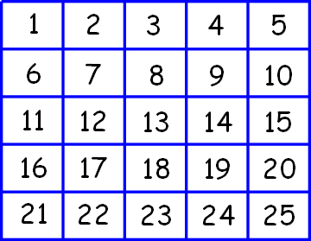
Now Try it for Yourself
Repeat the same, but this time leave circled 5 numbers.
The sum of the 5 numbers is …………………

Slide 36
Language, Logical Thinking and Mathematics
Christina bought two camogie sticks at the same price. She also bought a helmet for EU 25. If Christina spent EU 68 in total, how much did one camogie stick cost?

Slide 37
Language, Logical Thinking and Mathematics
Christina bought two camogie sticks at the same price. She also bought a helmet for EU 25. If Christina spent EU 68 in total, how much did one camogie stick cost?
1st Attempt:
68-25=43 / 2=21.5
Correct?

Slide 38
Camogie problem – Take 2
Christina bought two camogie sticks at the same price. She also bought a helmet for EU 25. If Christina spent EU 68 in total, how much did one camogie stick cost?
2nd Attempt:
Step 1: How much did Christina spend on camogie sticks?
68-25 = 43.
Step 2: If 2 camogie sticks cost EU 43
Then 1 camogie stick costs EU 43 / 2=21.5
The task was neatly divided into steps, each with clearly stated goals.

Slide 39
Ballroom Problem
In a ballroom, a number of couples (consisting of one man and one woman) are dancing. We are told that 2/3 of the men in the room are dancing, and that 3/4 of the women in the room are dancing. What fraction of the people in the room are dancing?
genius

Slide 40
Ballroom Problem – Take 1
In a ballroom, a number of couples (consisting of one man and one woman) are dancing. We are told that 2/3 of the men in the room are dancing, and that 3/4 of the women in the room are dancing. What fraction of the people in the room are dancing?
1st Attempt:
Correct?

Slide 41
Ballroom Problem – Take 2
In a ballroom, a number of couples (consisting of one man and one woman) are dancing. We are told that 2/3 of the men in the room are dancing, and that 3/4 of the women in the room are dancing. What fraction of the people in the room are dancing?
genius

Slide 42
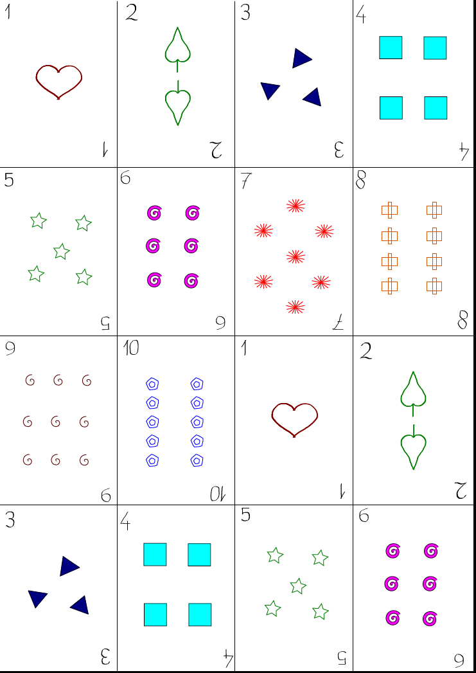
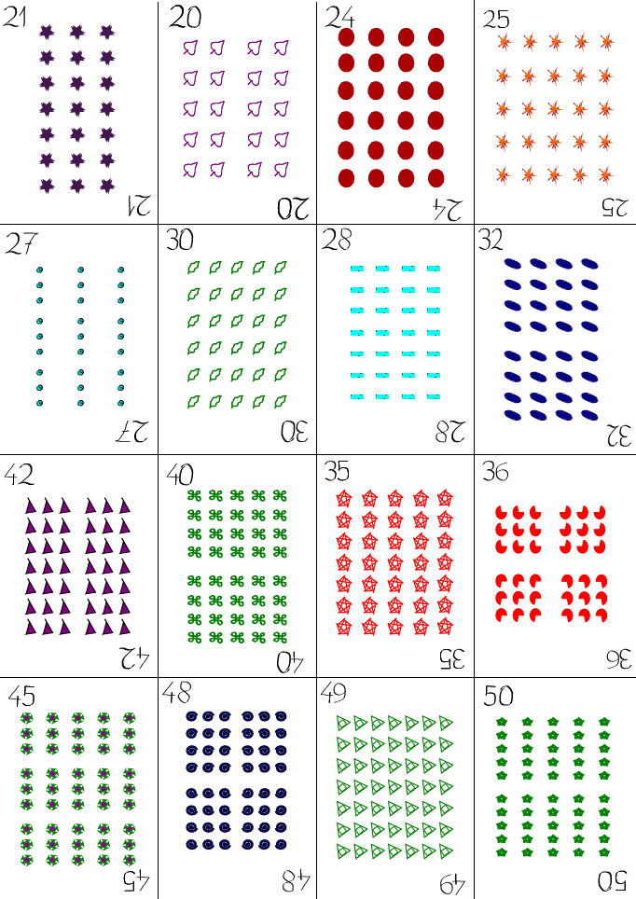
Numbers and operations

